Slide 1

Continuous Delivery with Azure DevOps
Mickey Gousset
mickey.gousset@microsoft.com
@mickey_gousset
Room 2206
Notes:
M

Slide 2
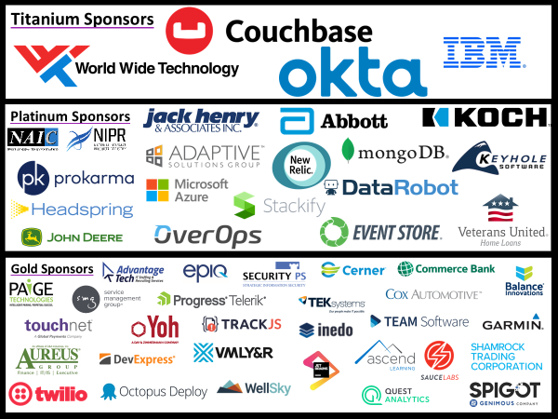
Thank You Sponsors!

Slide 3



What is Tupelo, MS world-famous for?

Slide 4
Agenda
Level-set the topic
Build pipelines
Release pipelines
YAML pipelines
Working with GitHub

Slide 5
This session needed a better name…
Continuous Integration (CI) | Continuous Delivery (CD) | Continuous Deployment (CD)
Practice of merging code changes into shared mainline several times a day Usually in combination with automated unit tests and an automated build process GOAL: avoid integration purgatory | Actually part of CI Ensures you can release new changes in a repeatable fashion Implies you have automated both your build and release processes “Deploy with the click of a button” – deploy early and often Continuous Delivery – We could release if we want to | Every change that passes all pipelines stages is released No human intervention Failed tests or gates prevent deployment Fast feedback loop between commits and release
Notes:
More information: https://www.atlassian.com/continuous-delivery/principles/continuous-integration-vs-delivery-vs-deployment

Slide 6
Accelerating Delivery with DevOps
Develop
“
DevOps is the union of people, process, and products to enable continuous delivery of value to your end users.
”
DevOps
Operate
Deliver

Slide 7
General Principles
Automate everything
Shift left on quality
Build once, deploy many
Same bits everywhere
Set configuration at deployment time
Same deployment process for all environments

Slide 8





Introducing Azure DevOps
Azure Boards
Azure Pipelines
Azure Repos
Deliver value to your users faster using proven agile tools to plan, track, and discuss work across your teams.
Build, test, and deploy with CI/CD that works with any language, platform, and cloud. Connect to GitHub or any other Git provider and deploy continuously.
Get unlimited, cloud-hosted private Git repos and collaborate to build better code with pull requests and advanced file management.
Azure Test Plans
Azure Artifacts
➔
Test and ship with confidence using manual and exploratory testing tools.
Create, host, and share packages with your team, and add artifacts to your CI/CD pipelines with a single click.
https://azure.com/devops
Notes:
So does TFS

Slide 9

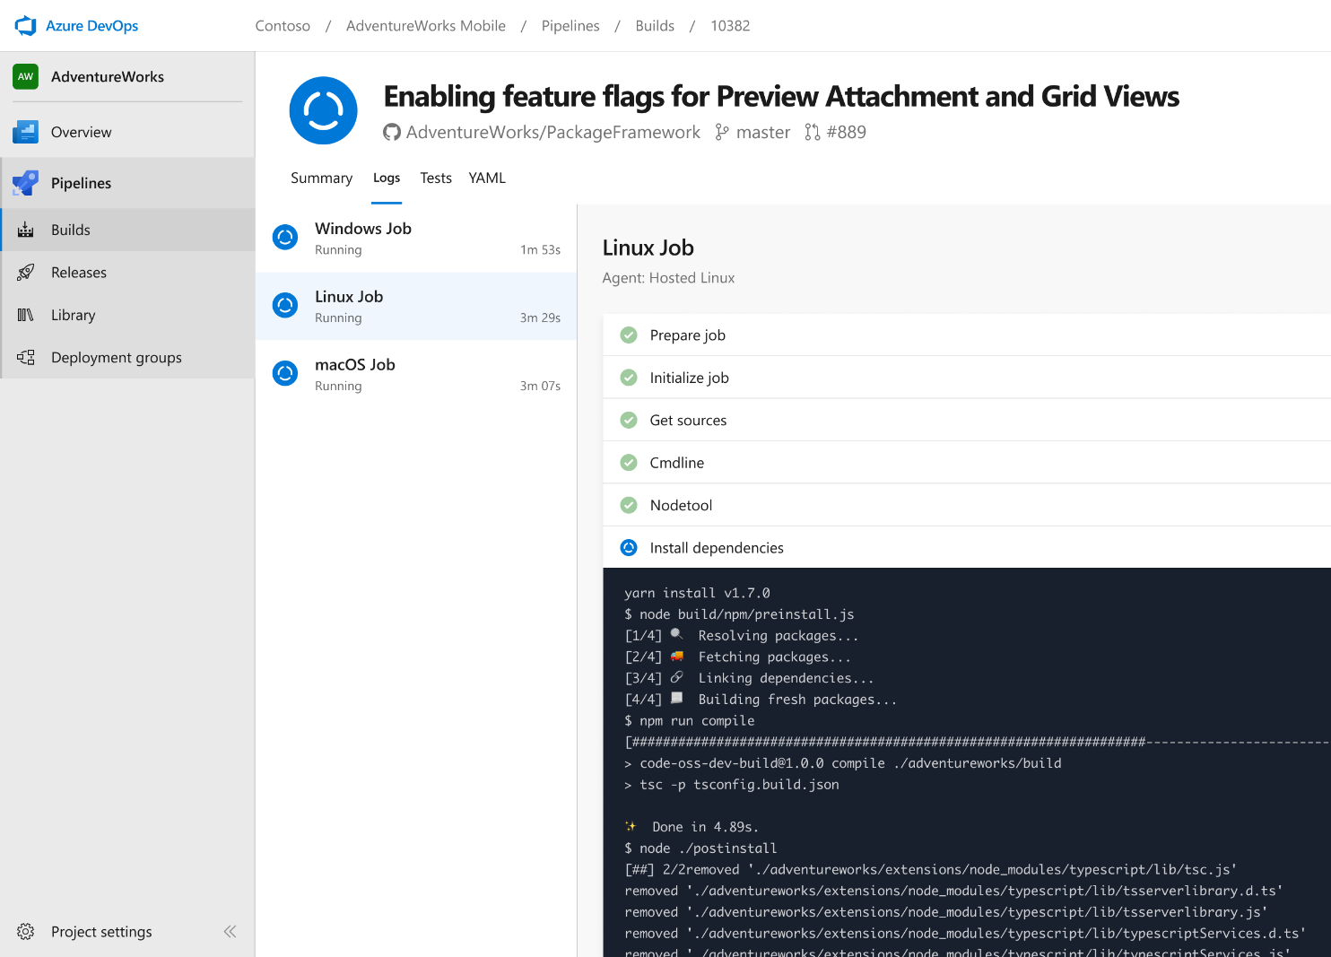




Azure Pipelines
Cloud-hosted pipelines for Linux, Windows and macOS, with unlimited minutes for open source
Any language, any platform, any cloud
Build, test, and deploy Node.js, Python, Java, PHP, Ruby, C/C++, .NET, Android, and iOS apps. Run in parallel on Linux, macOS, and Windows. Deploy to Azure, AWS, GCP or on-premises
Extensible
Explore and implement a wide range of community-built build, test, and deployment tasks, along with hundreds of extensions from Slack to SonarCloud. Support for YAML, reporting and more
Containers and Kubernetes
Easily build and push images to container registries like Docker Hub and Azure Container Registry. Deploy containers to individual hosts or Kubernetes.
Best-in-class for open source
Ensure fast continuous integration/continuous delivery (CI/CD) pipelines for every open source project. Get unlimited build minutes for all open source projects with up to 10 free parallel jobs across Linux, macOS and Windows
➔
https://azure.com/pipelines
Notes:
Azure Pipelines is the perfect launchpad for your code – automating your builds and deployments so you spend less time with the nuts and bolts and more time being creative

Slide 10
DEMO
Build Pipelines with Azure DevOps
Notes:
Things to discuss:
Agents
Cross platform (Windows, Linux, MacOs)
Execute “Jobs” (Build, deployment)
Runs Tasks in Steps
Build, tests, and/or deploys
Microsoft Hosted (Hosted Build)
Microsoft runs and manages the build agent
SW preinstalled and updated regularly
Self-Hosted (Private Build)
You manage and run the machine

Slide 11
DEMO
Release Pipelines with Azure DevOps
Notes:
Things to discuss:
Agents
Cross platform (Windows, Linux, MacOs)
Execute “Jobs” (Build, deployment)
Runs Tasks in Steps
Build, tests, and/or deploys
Microsoft Hosted (Hosted Build)
Microsoft runs and manages the build agent
SW preinstalled and updated regularly
Self-Hosted (Private Build)
You manage and run the machine

Slide 12
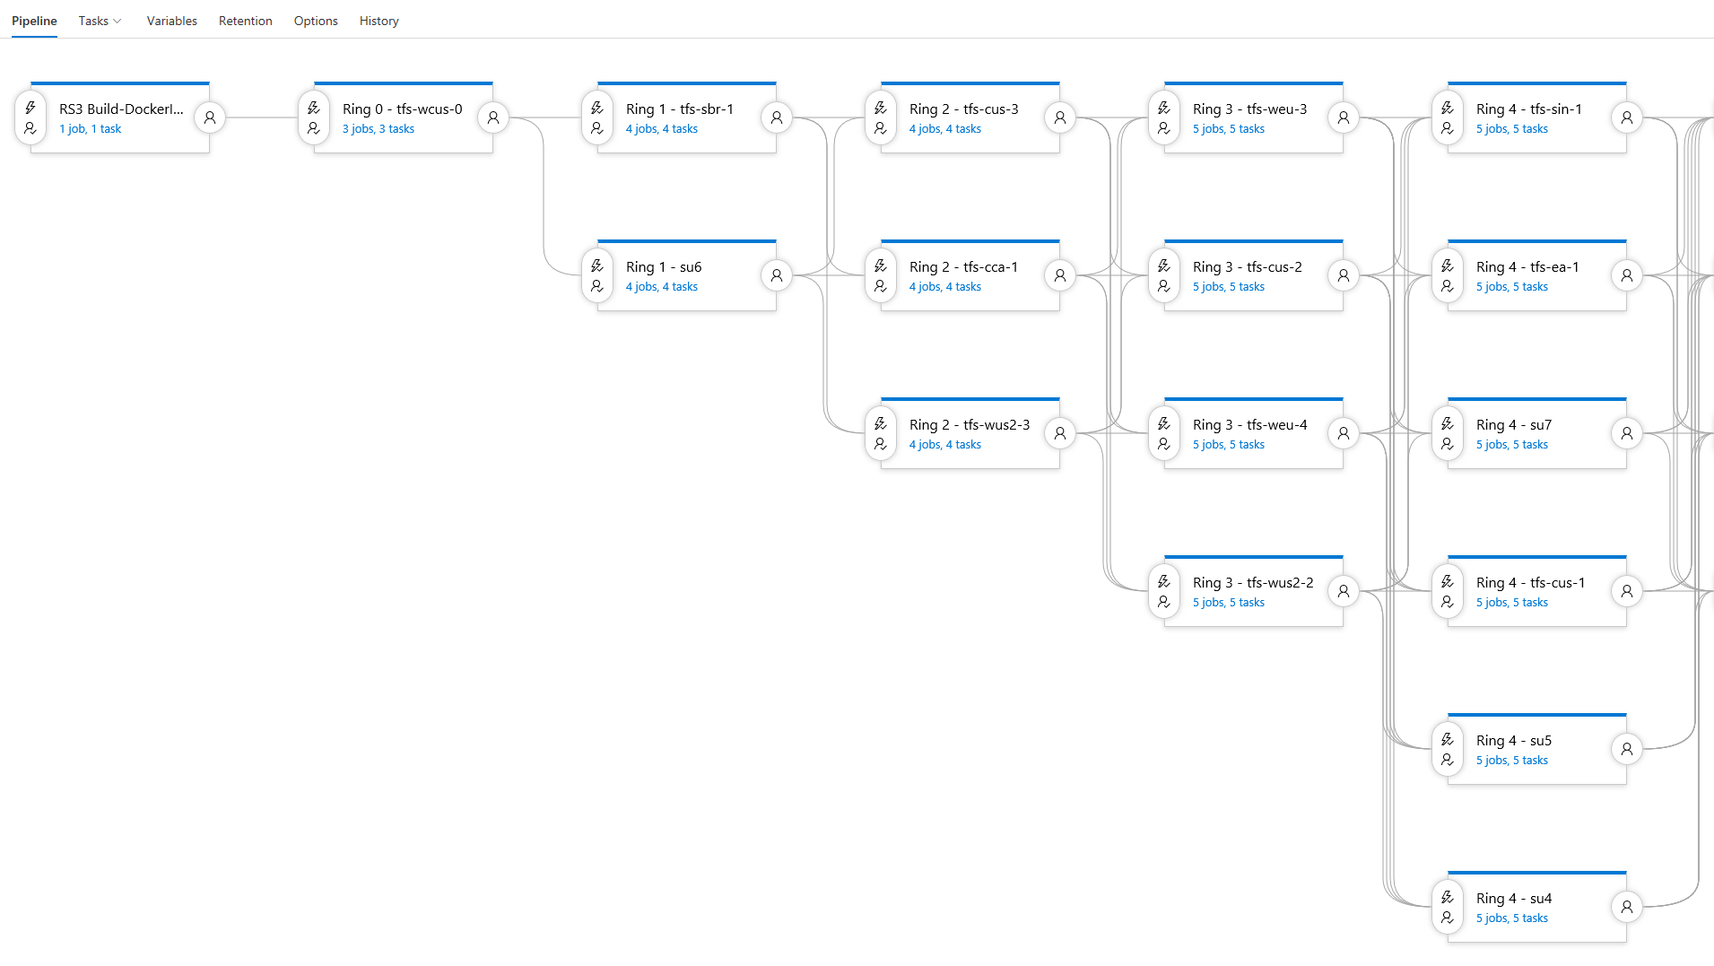
Progressive Exposure
Deploy one stage at a time
Release Gates control progression
Automated (L3) tests to check current ring
Can slow down with explicit approval
Result:
Visibility into impact of every deployment
Move across
Canary
Data centers with small user counts
Data center with large user count
Highest latency
The rest

Slide 13
DEMO
YAML Pipelines with Azure DevOps
Notes:
Things to discuss:
Agents
Cross platform (Windows, Linux, MacOs)
Execute “Jobs” (Build, deployment)
Runs Tasks in Steps
Build, tests, and/or deploys
Microsoft Hosted (Hosted Build)
Microsoft runs and manages the build agent
SW preinstalled and updated regularly
Self-Hosted (Private Build)
You manage and run the machine

Slide 14
DEMO
Working with Github
Notes:
Things to discuss:
Agents
Cross platform (Windows, Linux, MacOs)
Execute “Jobs” (Build, deployment)
Runs Tasks in Steps
Build, tests, and/or deploys
Microsoft Hosted (Hosted Build)
Microsoft runs and manages the build agent
SW preinstalled and updated regularly
Self-Hosted (Private Build)
You manage and run the machine

Slide 15
Travis Conversion Tips
Language Mappings
language=node_js
npm install
npm test
language=python
pip install –r requirements.txt

Slide 16
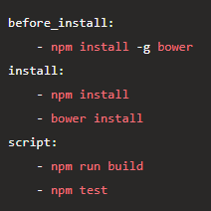
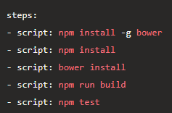
Travis Conversion Tips (cont.)
Travis has “phases”
before_install, install, after_install
In Azure Pipelines, you add a task and order them in sequence

Slide 17
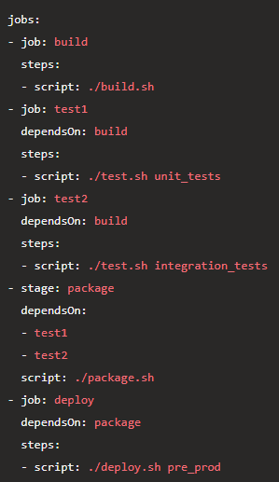
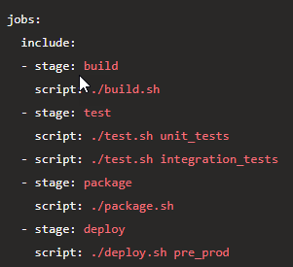
Travis Conversion Tips (cont.)
Parallel execution
Stages are groups of jobs that execute in parallel
Once all jobs in a stage complete, the next stage runs
In Azure Pipelines, you group tasks into jobs as well

Slide 18











DevOps CAT team mission
Work with Microsoft’s largest customers to help them accelerate their DevOps transformation.

Slide 19

Me
Mickey Gousset
Joined Microsoft June-18
Dev Tools MVP - 14 years
Tupelo, Mississippi, USA
@mickey_gousset
mickeygousset.com
mickey.gousset@microsoft.com

Slide 20
Thank You Sponsors!

